Slide 1

GETTING STARTED
Easy
FHE
Setup steps for EasyFHE usage

Slide 2

PRE-REQUIREMENTS
https://nodejs.org/en/download/

Slide 3

INSTALLING
Open the terminal and type the following command:
npm i -g @quasar/cli

Slide 4

CREATING THE QUASAR PROJECT
Open the terminal and type the following command:
npm init quasar
Go in 'quasar.config.js' and add to the build property the following:
extendWebpack(cfg) { cfg.experiments = { asyncWebAssembly: true, }; },

Slide 5

ADDING THE MODULE
Open the terminal and type the following command:
git clone https://github.com/mihailpreda/fhe-module-typescript-wrapper.git easyFHE
cd easyFHE
npm install
Then go to Quasar project's 'package.json' file and add EasyFHE to dependencies like:
easyFHE : file:../easyFHE

Slide 6
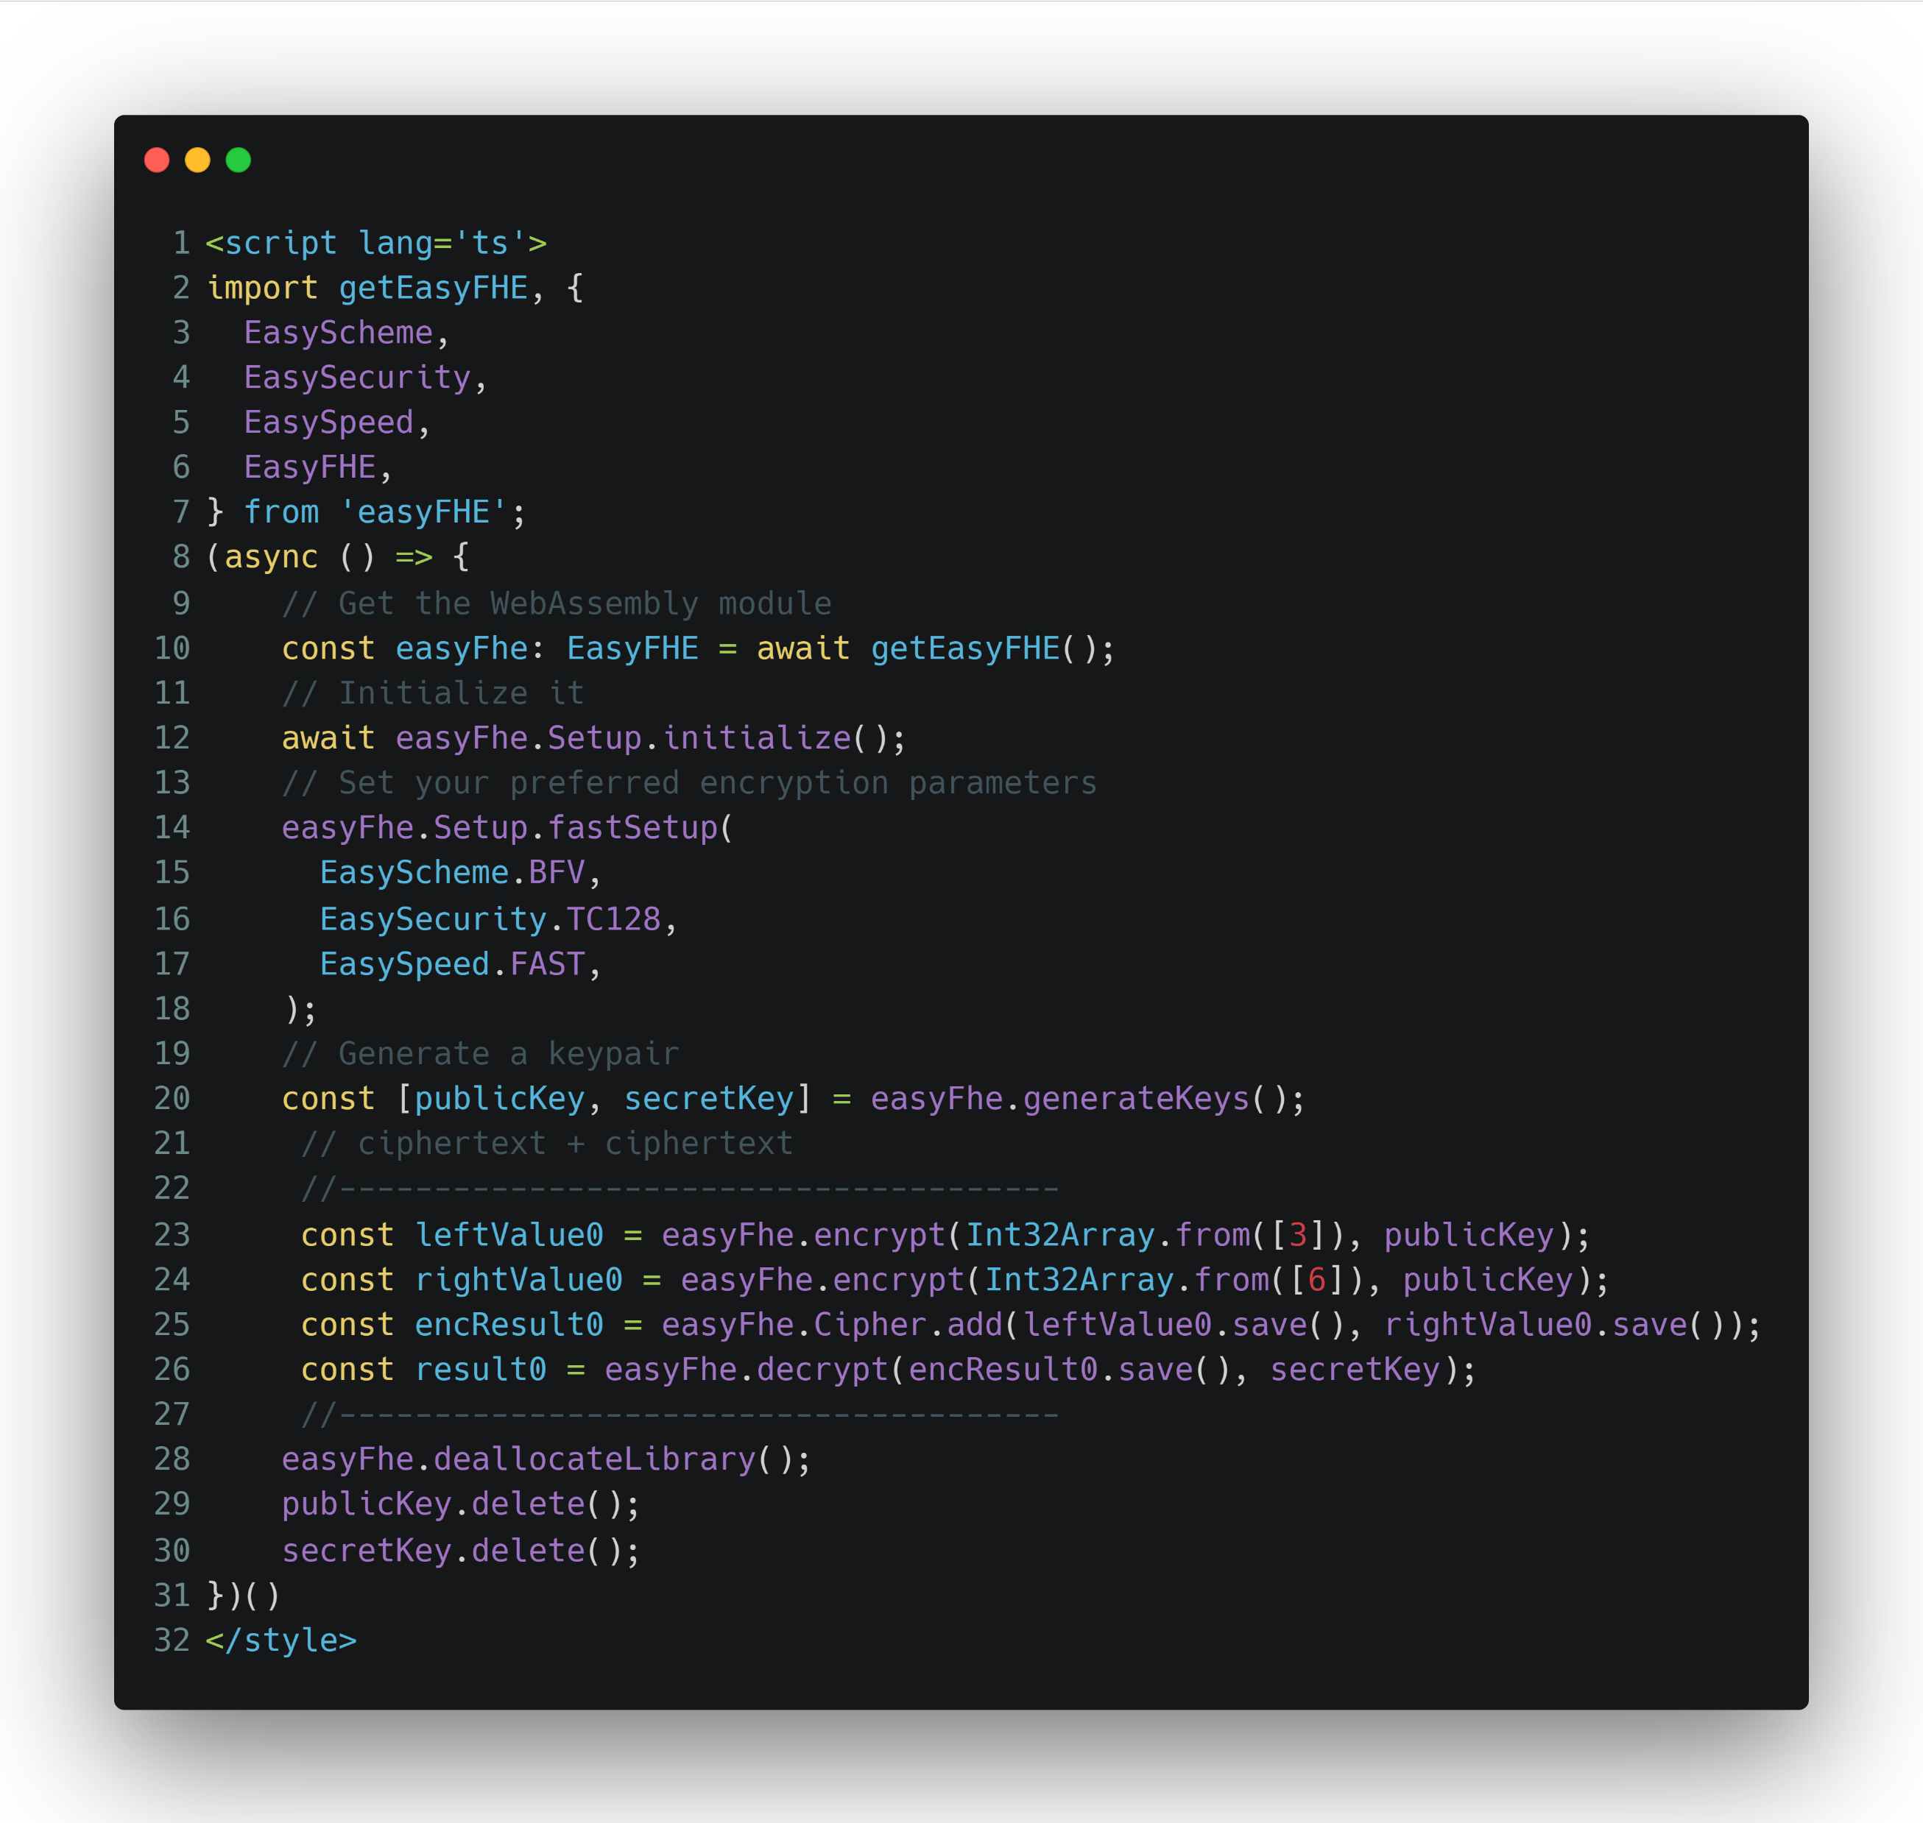
USAGE EXAMPLE

Slide 7

CONTACT
Preda Mihail Irinel
mihaipreda1997@gmail.com

